Slide 1
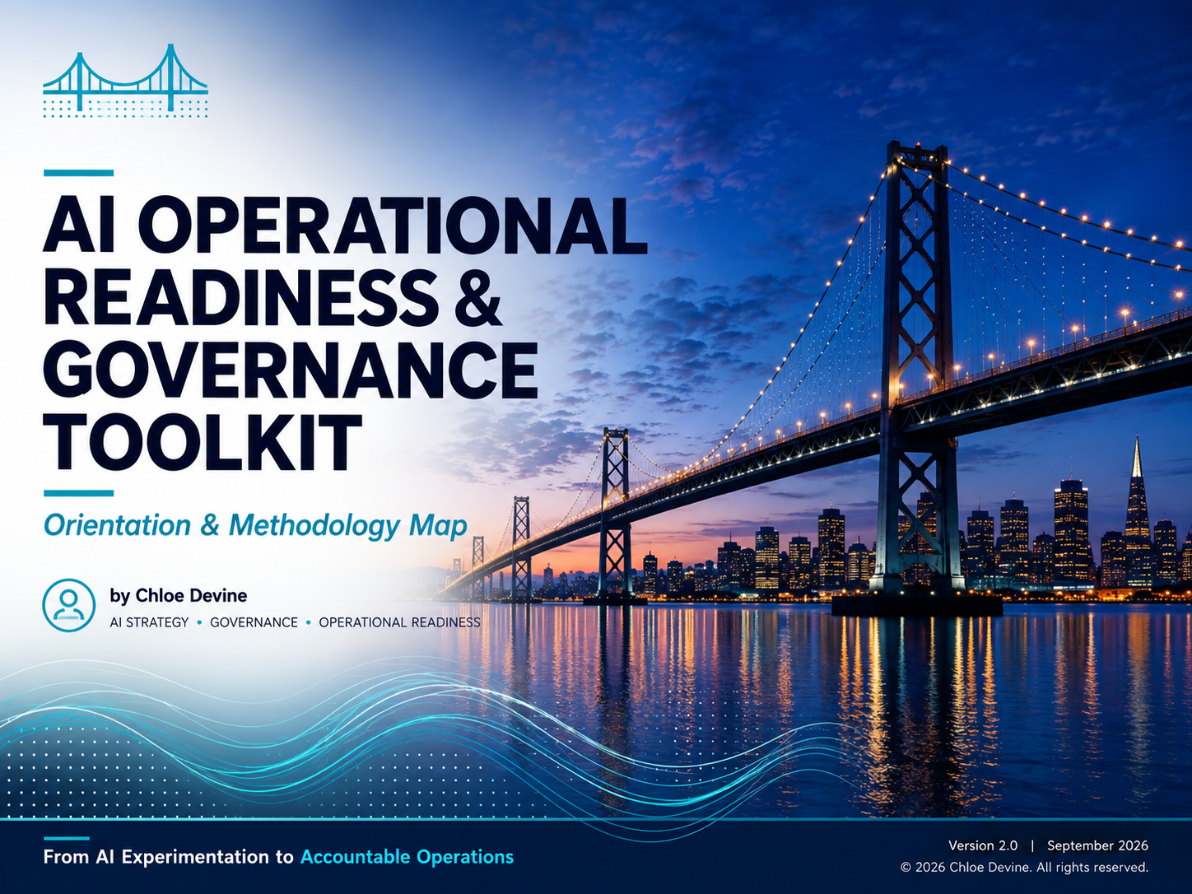

Slide 2
Methodology Overview
Understanding how the assets work together
Purpose
The AI Operational Readiness & Governance Toolkit provides a structured approach for helping organizations move from AI experimentation to accountable operations. Each asset supports a different part of understanding the work, evaluating opportunities, designing AI-enabled workflows, establishing governance and evidence requirements, preparing for implementation, and sustaining accountability in operation.
Core Flow
Discover → Prioritize → Classify → Design → Govern → Evidence → Prepare → Operate
What This Methodology Helps Define
Toolkit Asset | Question It Answers
AI Opportunity Discovery Workbook | What is happening today, and where are the opportunities, constraints, and risks?
Opportunity Prioritization Matrix | Which opportunities deserve further attention?
AI Use Case Categories | What AI capability pattern does the work require?
Current-State → Future-State Framework | How should the work change?
Decision Rights Framework | Who reviews, approves, escalates, intervenes, and remains accountable?
Evidence Framework | What must be observed, retained, and verified?
Pilot Readiness Framework | Is the operating model ready to test and learn?
AI Opportunity Executive Briefing | What does leadership need to understand to decide?
Guiding Philosophy
AI Operational Readiness & Governance is a connected methodology for moving from uncertainty to accountable operations. The assets support the lifecycle; they are not intended to operate as isolated checklists.

Slide 3
Methodology Map
Understanding the sequence of the assets
Discover Discovery Workbook
↓
Prioritize Opportunity Prioritization Matrix
↓
Classify AI Use Case Categories
↓
Design Current-State → Future-State Framework
↓
Govern Decision Rights Framework
↓
Evidence Evidence Framework
↓
Prepare Pilot Readiness Framework
↓
Operate ↺ Monitor • Learn • Change • Reassess
Understand
Executive Briefing:
Lifecycle → Evidence and decisions → Executive Briefing
Design
Guiding Philosophy:
AI Operational Readiness & Governance is a connected methodology, not a collection of independent frameworks.
The lifecycle is connected, not strictly linear. New evidence, changing conditions, or material changes may return the organization to an earlier stage.
Govern
Prepare
Operate

Slide 4
How the Toolkit Assets Work
Understand the Work | Design the Operating Model | Establish Accountability | Prepare to Learn | Synthesize the Decision
Discover Workbook | Current-State → Future State Framework | Decision Rights Framework | Pilot Readiness Framework | AI Opportunity Executive Briefing
Opportunity Prioritization Matrix |  | Evidence Framework
AI Use Case Categories
Guiding Philosophy
The assets build on one another, but practitioners may return to earlier assets as evidence, risk, operating conditions, or design assumptions change.

Slide 5
Asset Map
Stage | Asset | Primary Output
Discover | Discovery Workbook | Operational themes, opportunities, constraints, risk, signals
Prioritize | Opportunity Prioritization Matrix | Prioritized opportunities and implementation considerations
Classify | AI Use Case Categories | Primary/supporting AI capability patterns and action implications
Design | Current-State → Future-State Framework | Proposed AI-enabled operating model
Govern | Decision Rights Framework | Review, approval, escalation, intervention, accountability and authority model
Evidence | Evidence Framework | Evidence requirements, signals, provenance, and monitoring approach
Prepare | Pilot Readiness Framework | Pilot boundaries, learning plan, readiness conditions and exit criteria
Synthesize | AI Opportunity Executive Briefing | Executive recommendation and decisions required

Slide 6
From Discovery to Accountable Operations
Discovery Operational Understanding
↓
Prioritization & Classification Opportunity + Capability Pattern
↓
Future State Design Proposed Operating Model
↓
Decision Rights + Evidence Accountability + Evidence Requirements
↓
Pilot Readiness Bounded Learning Plan
↓
Leadership Decision Proceed • Revise • Hold • Stop
↓
Operation Monitor • Intervene • Learn • Change • Reassess ↺
Guiding Philosophy:
The methodology’s purpose is not to produce documentation. It supports better decisions and preserves accountability as operating conditions change.

Slide 7
Key Principles
Understanding the philosophy behind the methodology
Start with work, not tools.
Policy is not the operating model.
Access does not equal authority.
Human involvement does not equal human accountability.
Controls should be executable, not merely documented.
Governance decisions should rely on sufficient, trustworthy evidence.
Pilot the operating model, not just the technology.
Changing conditions can change the validity of prior decisions.
Accountability must persist after launch.

Slide 8
About this Orientation & Methodology Map
Companion Resource
This Orientation & Methodology Map is designed to be used with the AI Operational Readiness & Governance Practitioner Guide and AI Operational Readiness and Governance Toolkit.
For the complete methodology, principles, and lifecycle content, access the Practitioner Guide here:
Access the AI Operational Readiness & Governance Practitioner Guide on Zenodo
Access the Toolkit here:
AI Operational Readiness & Governance Toolkit | Zenodo
Use & Attribution
© 2026 Chloe C. Devine. All rights reserved. You may use this resource in its original form for practitioner reference and application. When referenced, reproduced, presented, or incorporated into other work, attribution to Chloe C. Devine and the AI Operational Readiness and Governance Practitioner Guide is required.
You may not alter or republish the underlying framework, instructional content, attribution, or methodology as a modified work without permission.
AI Assistance Disclosure
AI tools supported research synthesis, content organization, editing, and design assistance in developing this resource. The framework, methodology, practitioner guidance, and final editorial decisions were developed and reviewed by Chloe C. Devine.
Practitioner Notice
This resource provides practical guidance and is not a substitute for legal, regulatory, security, compliance, or other professional advice. Organizations should adapt its application to their specific context, risks, policies, and obligations.
AI Operational Readiness & Governance Toolkit: Orientation & Methodology Map | Version 2.0 | September 2026
DOI: 10.5281/zenodo.22983272
https://doi.org/10.5281/zenodo.22983272

